Slide 1
Cognitive Dissonance Theory

Slide 2


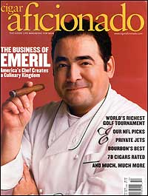
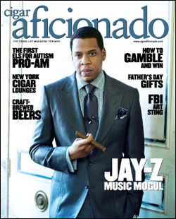
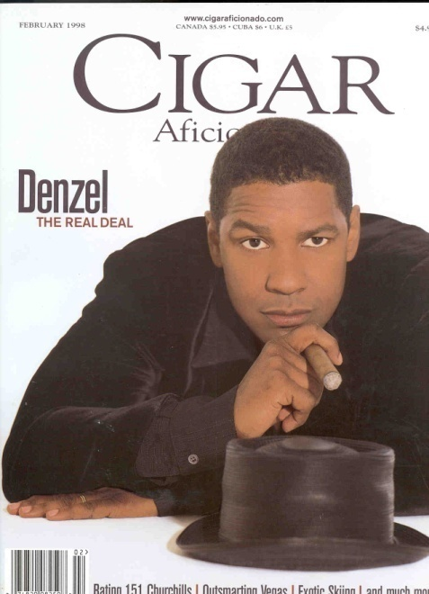
Cigar Aficionado Magazine
What’s your image of cigars and cigar smokers?
Is this the only image/information out there about cigars?
How do people respond to information that contradicts their behavior?

Slide 3
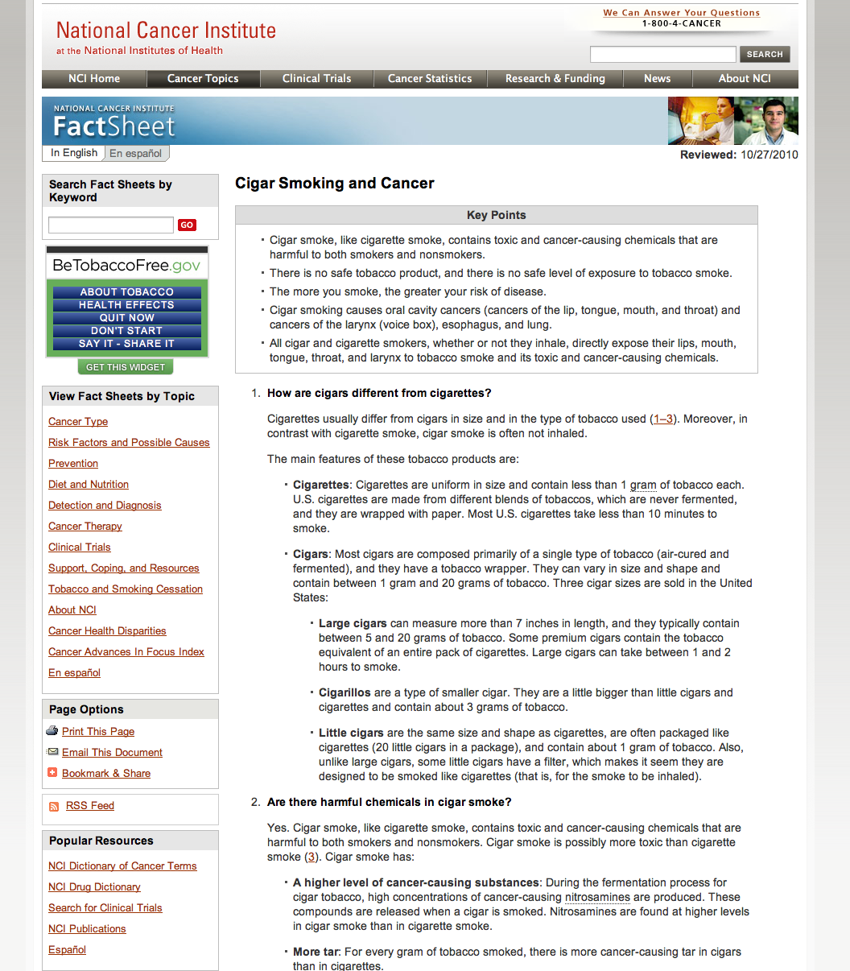
How do people reconcile this…

Slide 4


…with this?

Slide 5
Today’s Lecture
Talk about Cigar Aficionado’s depiction of cigar smoking.
The seven arguments FOR smoking cigars, according to Cigar Aficionado
Why Cigar Aficionado advances these arguments
Cognitive Dissonance Theory
Elements of the theory
Factors affecting the intensity of dissonance
Ways we control dissonance
How we can harness dissonance for persuasion

Slide 6
Cigar Aficionado vs. Medical Research
Are cigars good for you?
NCI and the American Cancer Society found that cigar smokers experience many of the same cancers as cigar smokers, largely because toxic carcinogens and nicotine are absorbed through the mucus membranes in the mouth. It should be noted that cigars are far larger in mass than cigarettes and require more time to smoke. This leads to increased duration of exposure to nicotine and tobacco-based carcinogens. Although cigar smokers are less likely to inhale cigar smoke, the higher concentration of nicotine in cigars makes this form of tobacco intake at least as addictive as cigarettes. Furthermore, the second-hand smoke generated by cigars is equally toxic as that of cigarettes (Baker, et. al, 2000, p.735).

Slide 7

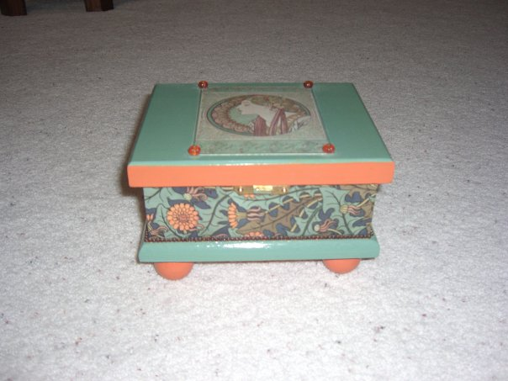
Meet Alan DeSantis

Slide 8
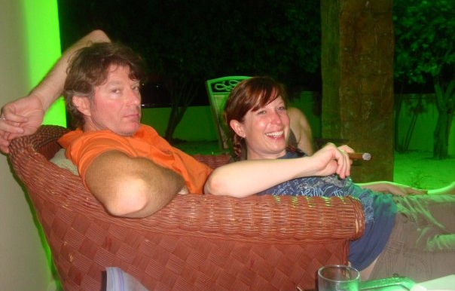
But I’m no angel, either…

Slide 9
The study
Alan DeSantis and I analyzed 8 years of issues of Cigar Aficionado.
CA makes some key claims that are of interest to their readers.

Slide 10
Why cigars are great: Cigar Aficionado’s 7 key arguments
Cigars-are-not-cigarettes argument
Life-is-dangerous argument
Health-benefits argument
Moderation argument
Old-smokers argument
Bad-science argument
Good-science argument

Slide 11
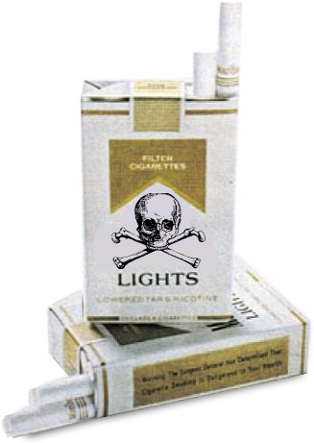
Cigars-are-not-cigarettes argument
Claim: Cigars are not as addictive as cigarettes
“The reality is that cigars don’t create the kind of compulsive addictions that other tobacco products may cause.” Many regular cigar smokers “often go days or weeks without smoking at all” (Marvin Shanken, publisher).
“The Surgeon General didn’t warn against [cigars] ” --Actor Ben Gazzara

Slide 12


Life-is-dangerous argument
Risk is part of living. Skiing, riding motorcycles, flying private airplanes, drinking whole milk, eating bacon, savoring butter and cream sauces or digging into a hamburger and fries are all things that have health risks. . . . Someday the fanatics will learn that there are not absolutes: Risks are everywhere, and if you can somehow get through the dangers of living every day, a relaxing smoke, especially after an enjoyable dinner, will make the passage all the sweeter.”

Slide 13
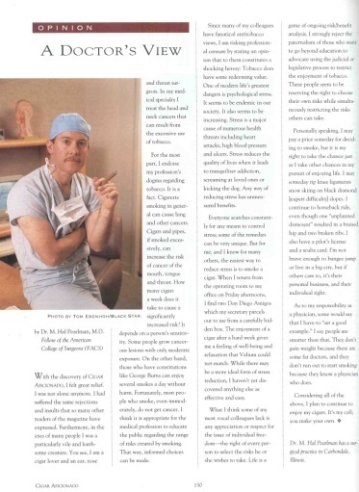
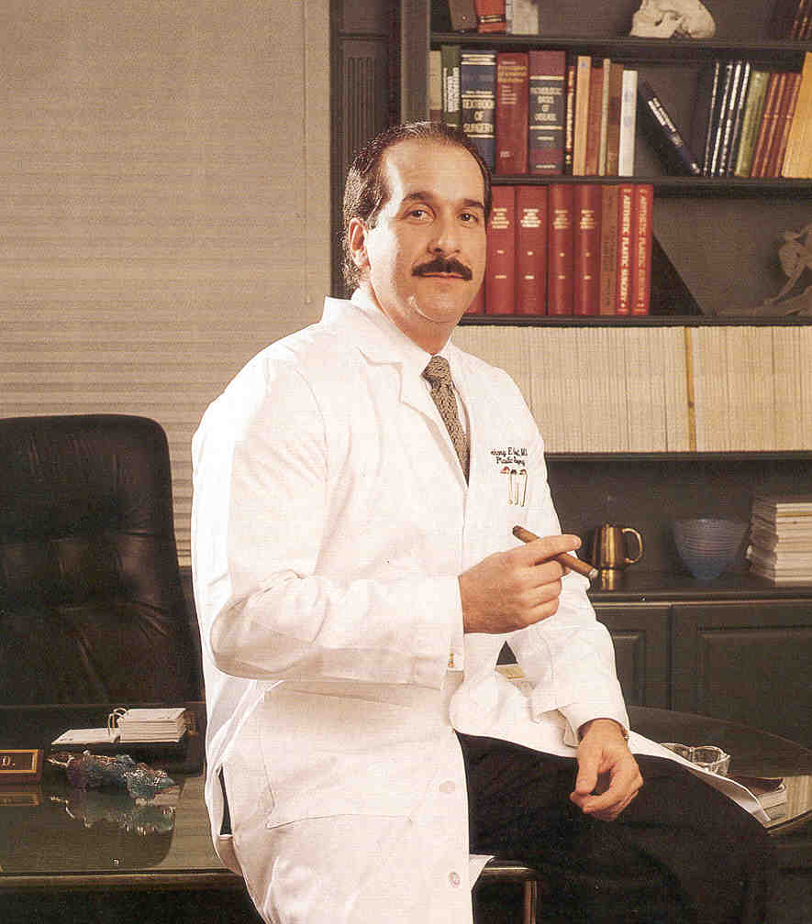
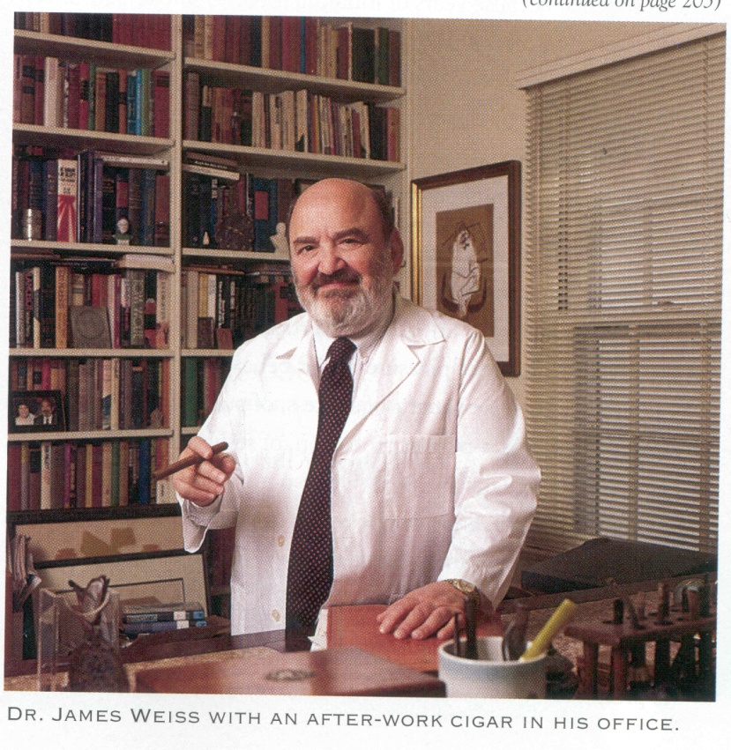
Health-benefits argument
“[A]s director of a center for stress-related disorders,” no other method, “from biofeedback to yoga,” has the advantages of smoking a cigar. --Dr. Charles Carluccio, “On Doctor’s Orders.”
“One of modern life’s greatest dangers is psychological stress. . stress is a major cause of numerous health threats, including heart attacks, high blood pressure and ulcers. Stress reduces the quality of lives when it leads to tranquilizer addiction, screaming at loved ones or kicking the dog. Any way of reducing stress has unmeasured benefits.” --Dr. M. Hal Pearlman, an ear, nose and throat surgeon.

Slide 14
Moderation argument
“A little bit of poison, taken in moderation, is good for you.” – Francis Ford Coppola, director.
Cigar smoking is only dangerous if done in excess.
No cigar smoker was ever portrayed as smoking excessively, whether it was David Shaw’s three per week (152 cigars a year), Francis Ford Coppola’s ten per week (520 cigars a year), or George Burns’ ten a day (3,650 cigars a year).

Slide 15
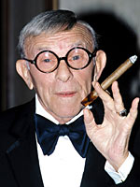
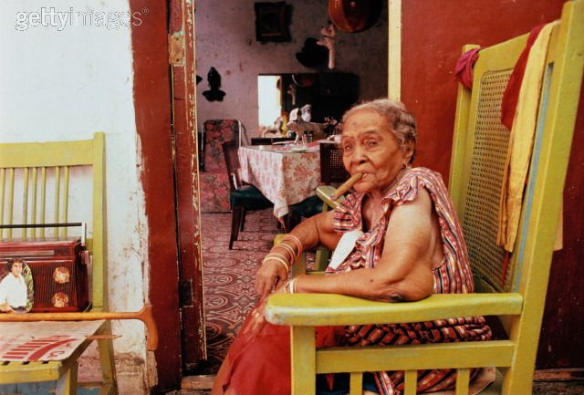
Old-smokers argument
Many column inches were devoted to describing the long lives of cigar smokers, from celebrities to elderly Cuban ladies.

Slide 16


Bad-science argument
Attacked medical research for their “improper scientific methodology” and their “lack of significant empirical data.”

Slide 17
Good-science argument
CA extracted findings from isolated studies that failed to link cigar smoke to elevated risks of cancer and praised those studies for demonstrating that cigar smoking was safe.
In essence, the only information that readers need pay attention to is that which points to a negligible level of risk of cigar smoking.

Slide 18
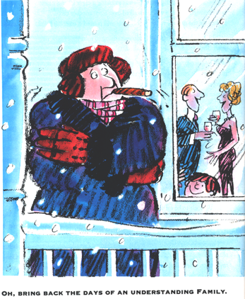
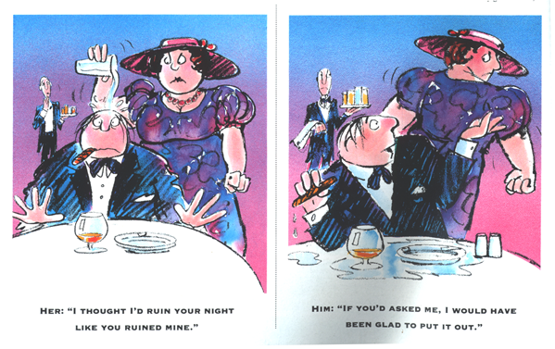
Why would Cigar Aficionado make these claims?
Cigar smokers are under assault from family, friends, and the public for their “stinky cigars” that “cause cancer.”
CA wants to bolster smokers’ defenses against these attacks, including the ones inside their own heads.

Slide 19
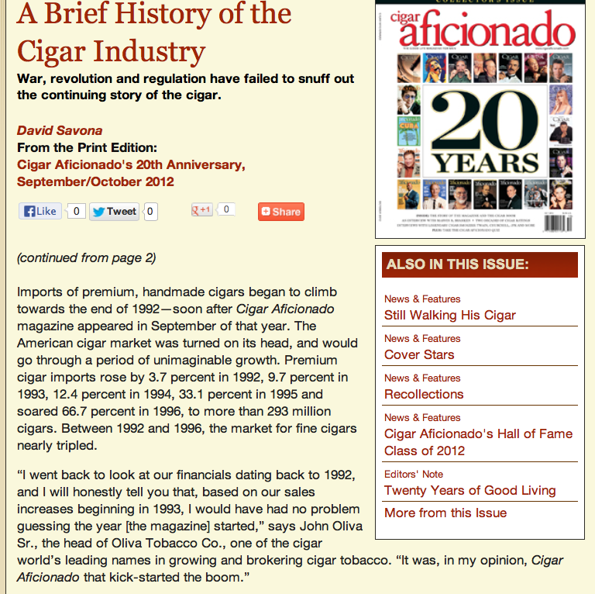
Is it just coincidence that the sale of cigars went up with CA?
Not according to CA!

Slide 20
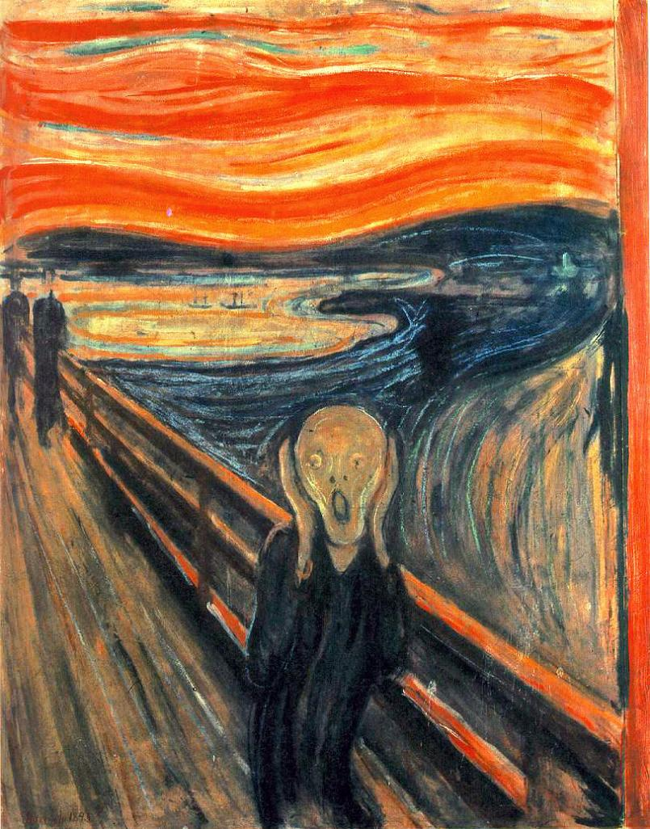
Cognitive Dissonance Theory
Cognitive dissonance theory is the best supported, most researched theory in the social sciences.
Psychology-based theory with applications to persuasion.

Slide 21
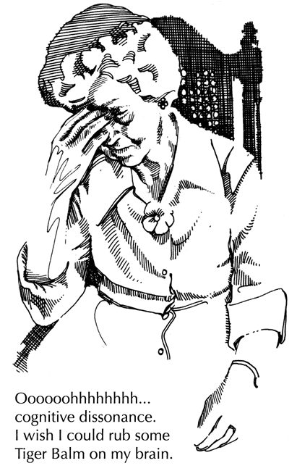
Central Premise
Humans have a drive to avoid cognitive inconsistency and will change their attitudes, alter their beliefs, and behave differently in order to prevent or reduce dissonance.

Slide 22
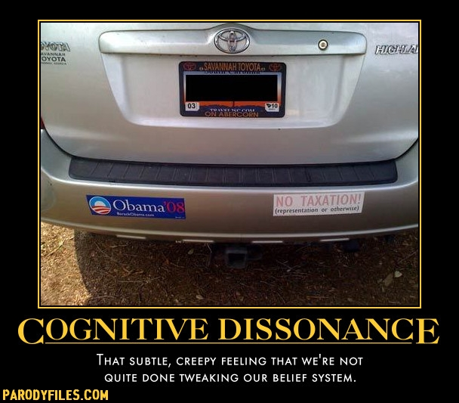
Cognitive Dissonance Theory
Attitude objects can have 3 possible relationships:
They can be consonant (in harmony)
They can be dissonant (in disharmony)
They can have no relationship

Slide 23
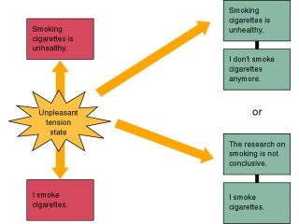
Dissonance as Drive State
The motivation to achieve consistency is a DRIVE STATE, like hunger or thirst.
As the magnitude of dissonance increases, so does the pressure to reduce it.

Slide 24
Factors influencing the intensity of dissonance
The relative proportion of consonant & dissonant elements.
The importance of elements or issues.
If the decision can be “undone.”
If you did something of your own free will.
If there are negative consequences.
If you had to choose between two options that were similar in attractiveness.

Slide 25
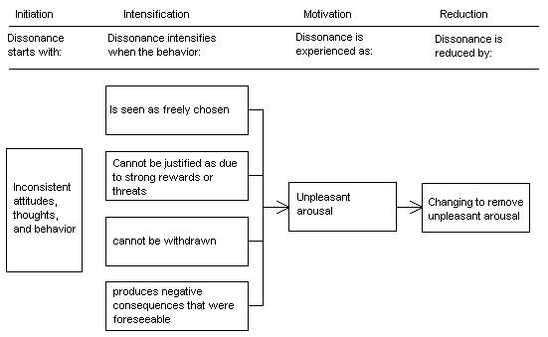

Slide 26
Effect of minimal justification
http://www.youtube.com/watch?v=korGK0yGIDo
Minimal justification for action induces a lasting shift in attitude.
The less justification for a dissonance producing act, the greater the likelihood that attitudes will change to reduce dissonance.
The justification must be of sufficient magnitude to cause the person to act in a manner counter to former attitudes or beliefs.
Ex: Asking participants in a dull task to promote it to others for $1 vs. $20.

Slide 27
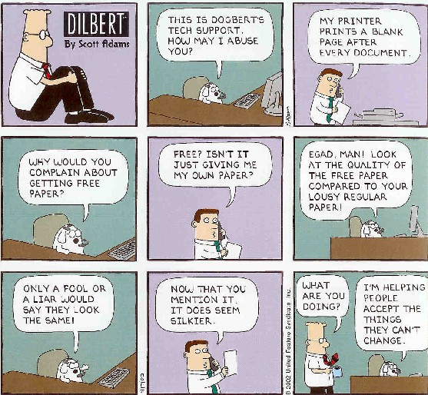
Ways to control dissonance
Change the relative proportions of consonant and dissonant elements.
Think of reasons why what you’re doing is good or persuade yourself that the bad stuff isn’t so bad.
Alter the importance of the issue or the elements involved.
Selective exposure prevents dissonance.
Notes:
Tie back to CA: Proportion of C/D elements (Reduces stress.→ bad science)
Alter importance: Old smokers, life is risky
Selective exposure: Hang out at Martin’s cigar shop.

Slide 28

Post-decision regret
Greater dissonance results if a choice is made between two alternatives that are of similar attractiveness.
Dissonance increases as the importance of the decision increases.
Dissonance increases as the difficulty of reversing the decision increases.

Slide 29
Commitment
Gaining commitment can be an effective tool for influence.
Flakiness and inconsistency are seen as socially undesirable in American and Western European cultures.
Compliance with a position someone has previously committed to is easy and straightforward in these cultures: Just point out the inconsistency between the position and current attitudes/behaviors.
Possible examples:
Public declaration of exercise/weight loss goals.
“You’re a health communication researcher! How can you smoke a cigar?!”

Slide 30
Gaining commitment
Start with something modest.
Seek harmless concessions.
Get them to write it down.
Make the commitment public.
Don’t give large inducements – make it an inner choice.

Slide 31

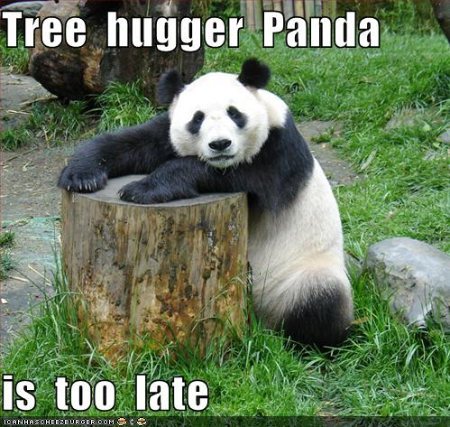
An issue can “grow legs”…
The pressure for consistency will extend beyond the initial influence issue.
If you are convinced you are environmentally conscious about water use, you will probably recycle other materials.

